Slide 1




PATCH MANAGEMENT
Team
Suryantho Wijaya
Petrus Agus Gabriel
Nur Hawi B Hamjah
Sarah Mutamimah

Slide 2

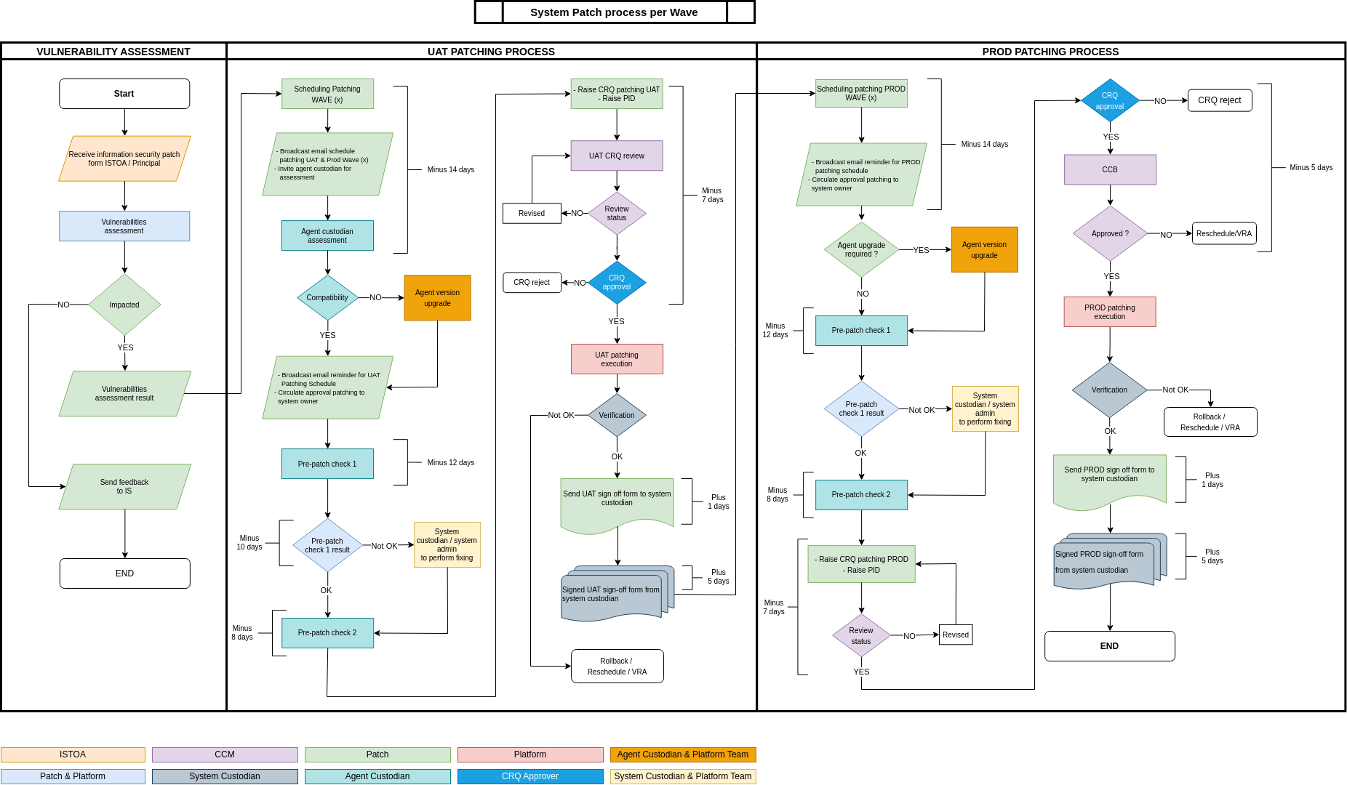
Patch Process

Slide 3

Achievement
Patch Management 2024
Vulnerability Assessment
Patch Wave Activity
Patch Process Improvement
Ontime CVE assessment responses
Ontime VA assessment responses
Better tracking for CVE that’s till *under investigation by Principal
100% patch compliancy on 2024
Ontime get system owner approval
Patchscheduling in between tight others activities
Non OS Agent compatibility check before patching
UAT-PROD Sign Off
Post Patch Verification improvement

Slide 4




TARGET
IMPROVEMENT Patch 2025
Tier1 active-active system new patch scheduling
Explore to operate automation tools for data verification
Re-design Patch Report

Slide 5



TERIMAKASIH
ATAS PERHATIANNYA
Patch Management

